Slide 1
Flash Analog-to-Digital Converter ECE 532 Project
Jiahui Yang Bingyu Zhang

Slide 2

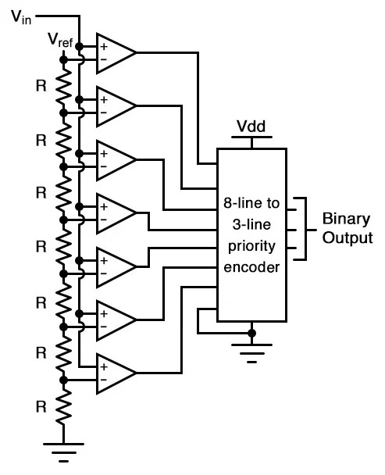
Structure of 3-bit Flash ADC
It consists of 3 main components:
Resistor Ladder (Voltage Divider)
Comparator Array
Priority Encoder

Slide 3
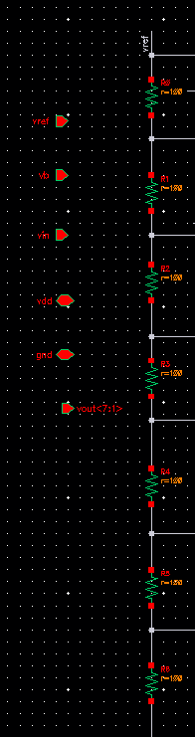
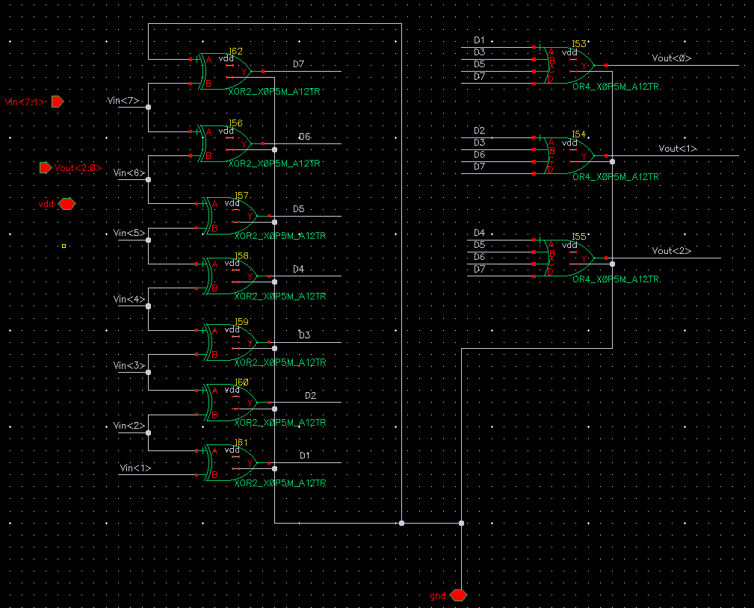
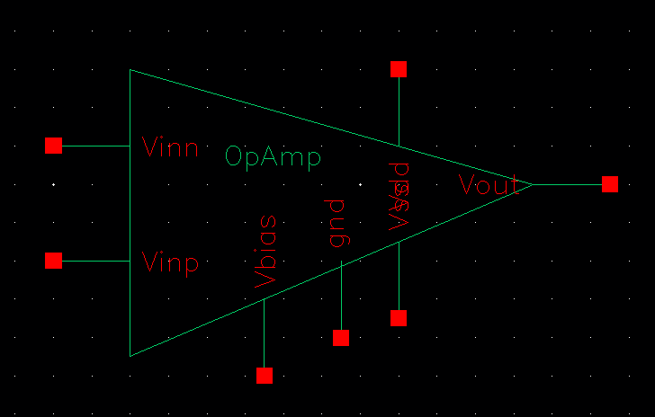
3-bit Flash ADC Schematic Snapshots
Differential Comparator
Analog
Priority Encoder
Digital
Resistor Ladder
Analog
100 Ohm resistors (x7)
Total Resistance = 700 Ohms

Slide 4
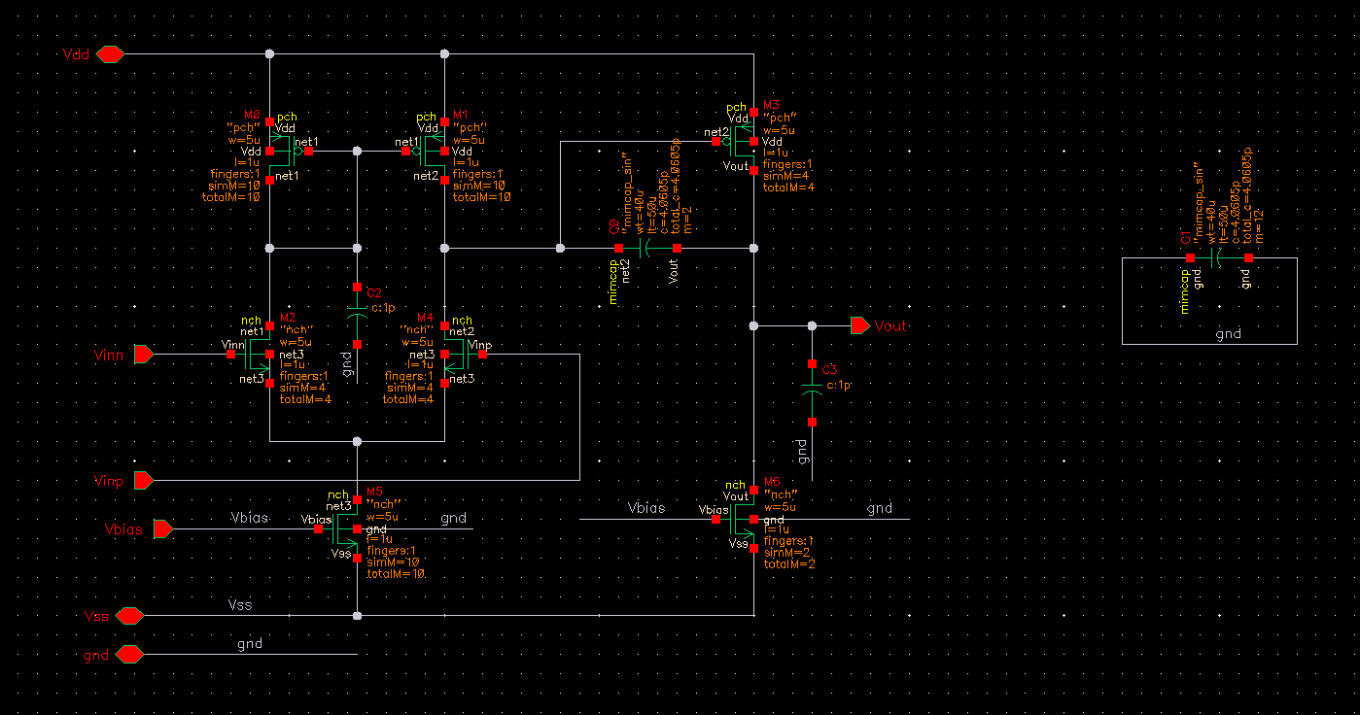

Differential Comparator
Differential Comparator
Analog
Notes:
1. Differential Pair (M2 和 M4)
它们的源极连接在一起
它们比较两个输入信号的电压差，决定哪一边导通更多。
2. Current Mirror (M0 和 M1)
3. M3 Provide Vout output (pull-up)
4. M5 提供电流源偏置（由 Vbias 设置）。
5. M6 Pull-down constant current source

Slide 5
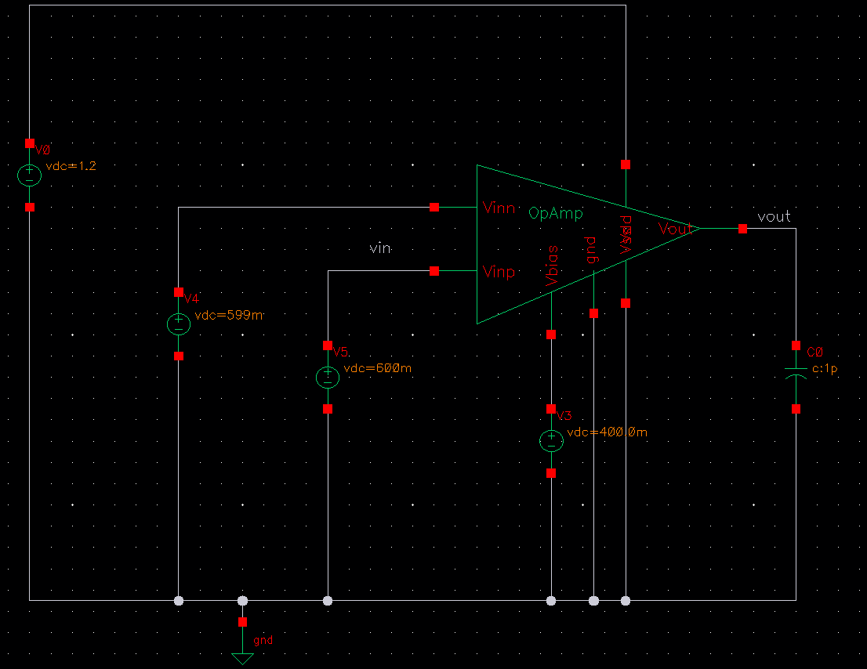
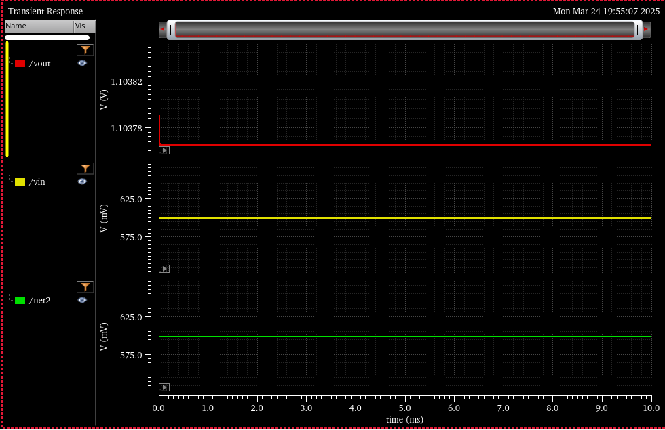
Differential Comparator Testing

Slide 6
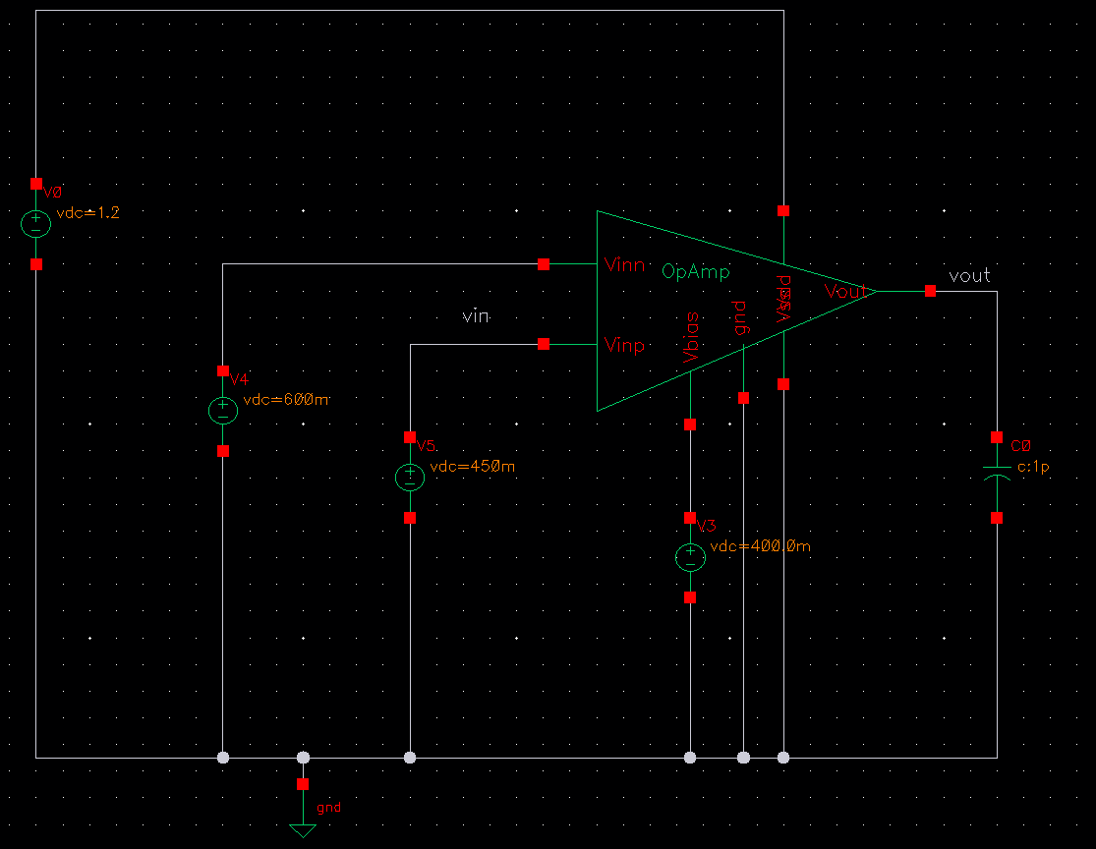
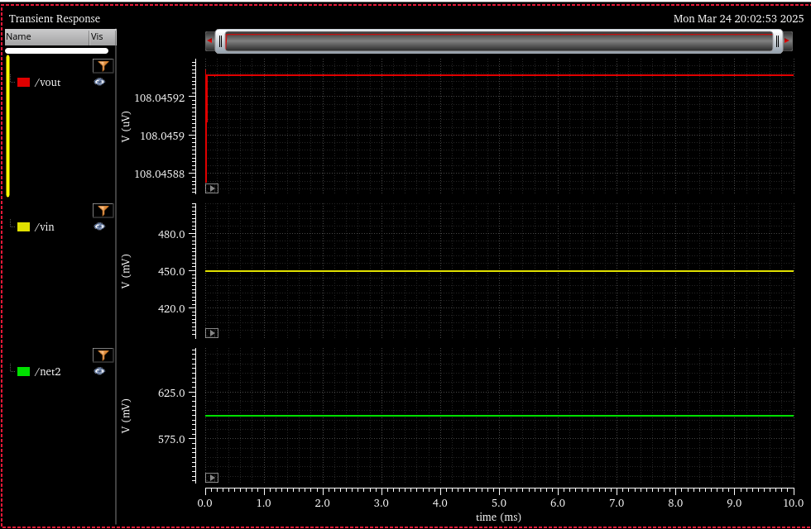
Differential Comparator Testing

Slide 7
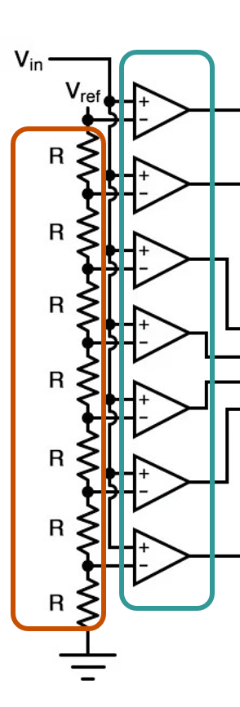
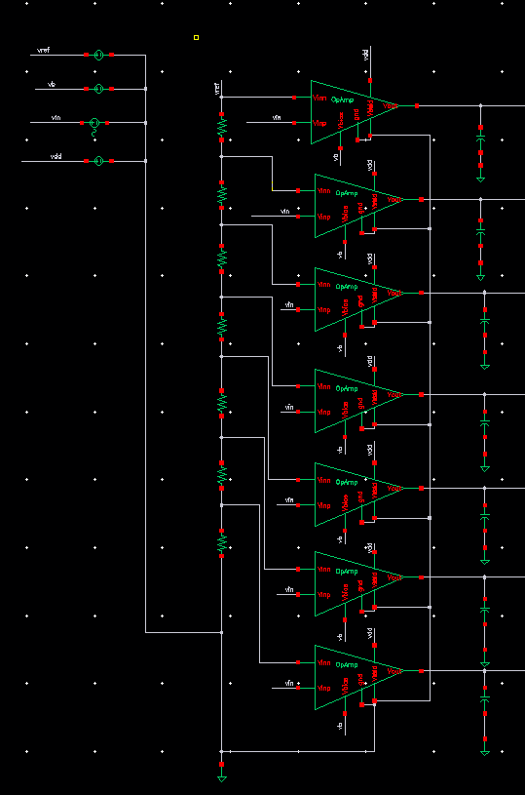
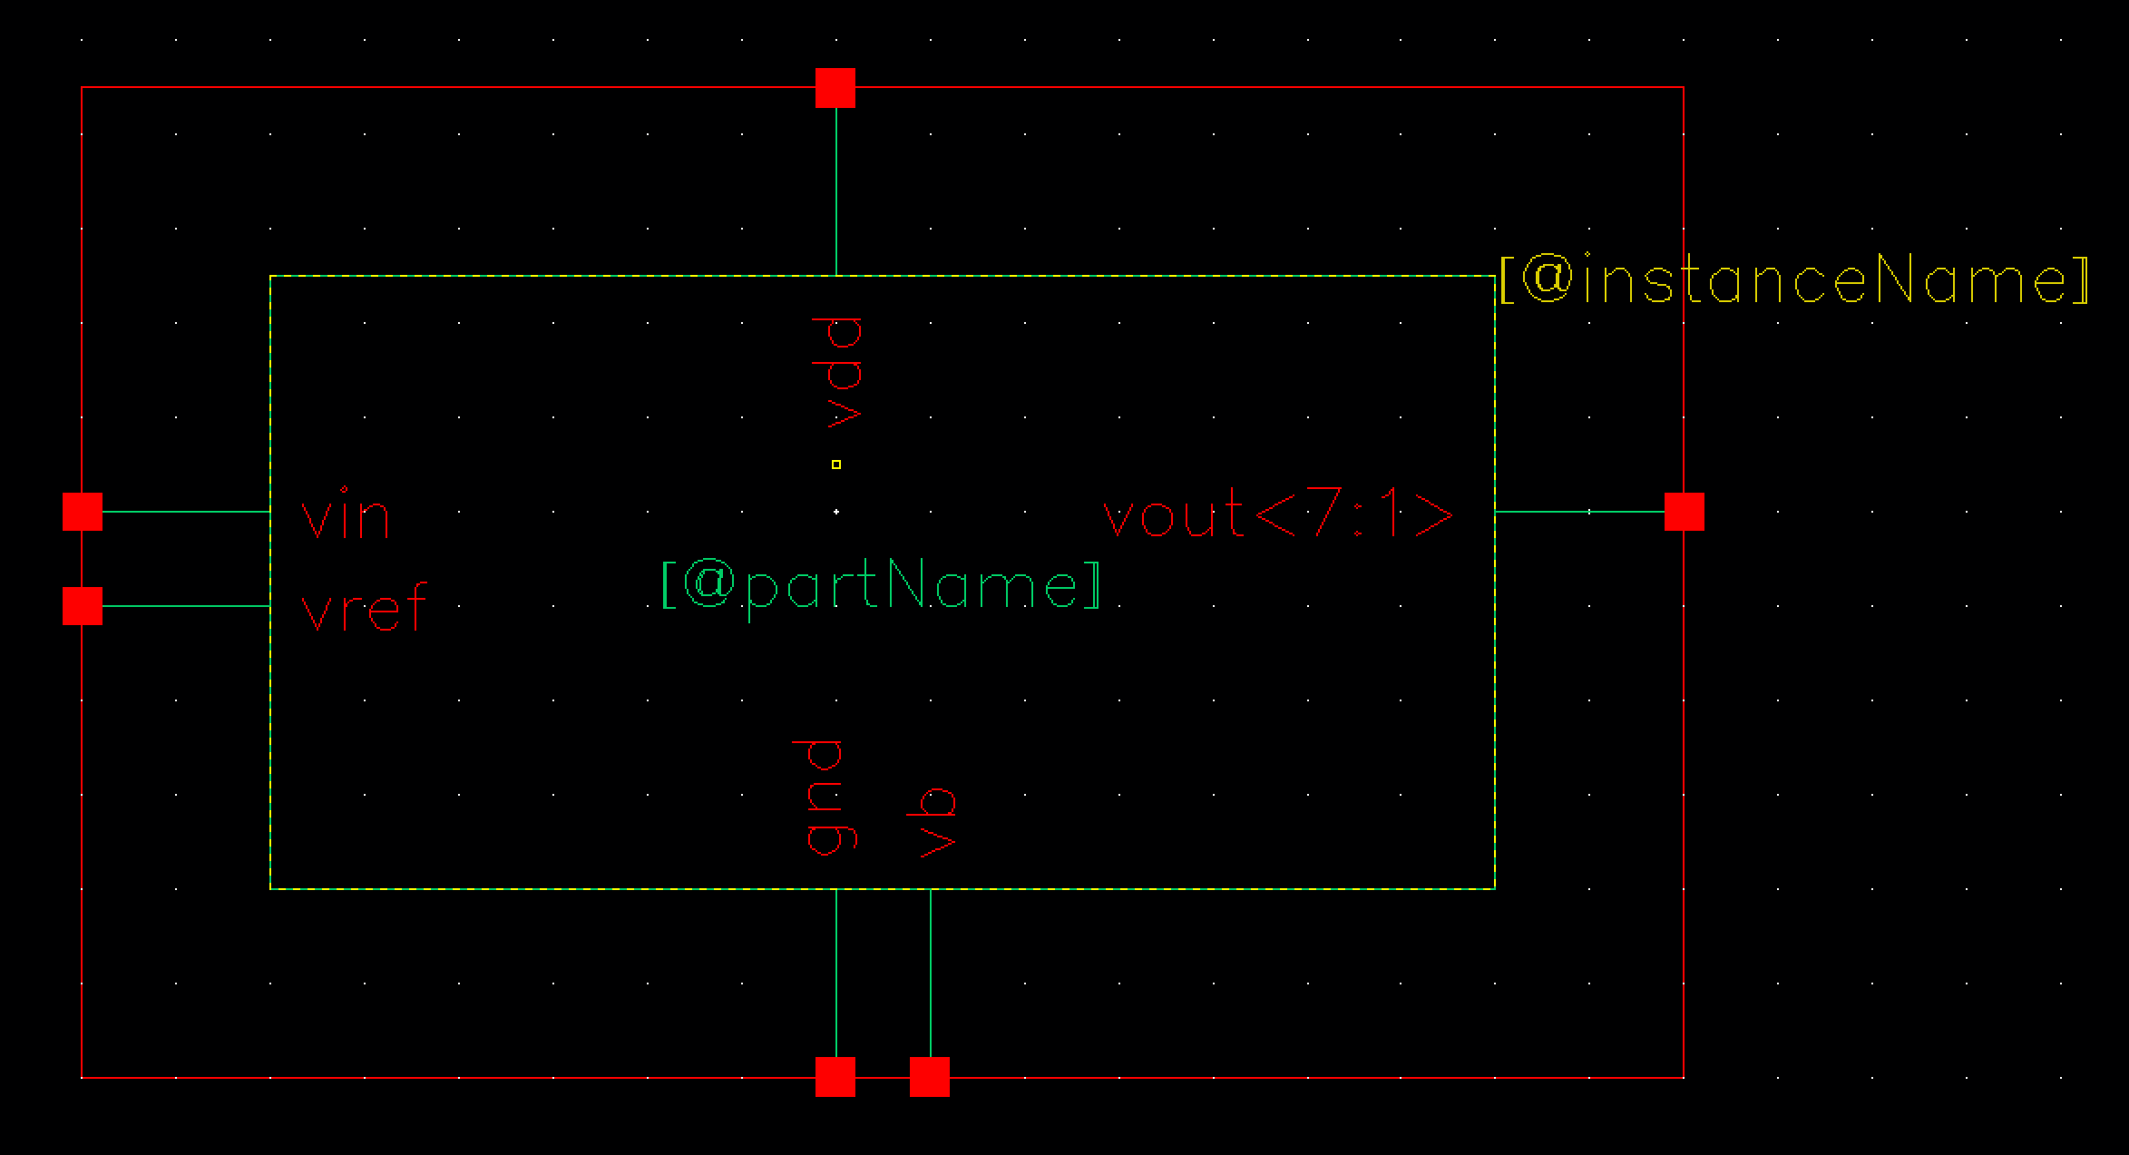
Voltage divider & Comparator Array
Resistors – all used 100 Ohms
Vref – 0.7 V
Symbol
Schematic

Slide 8
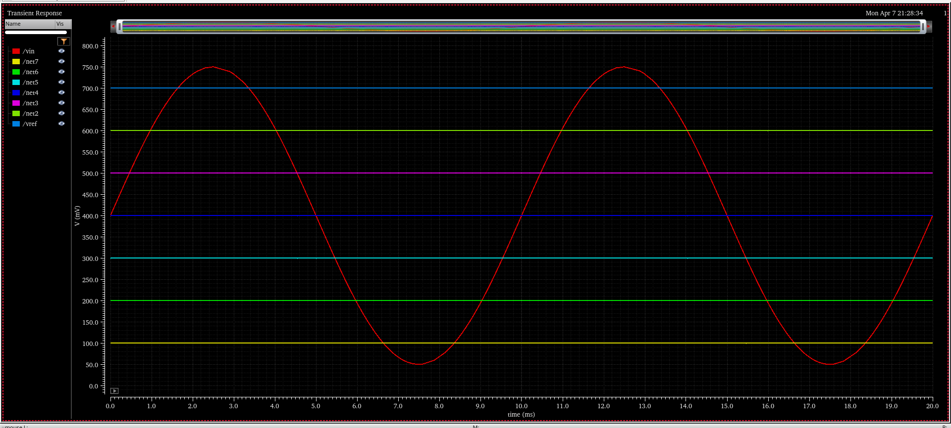
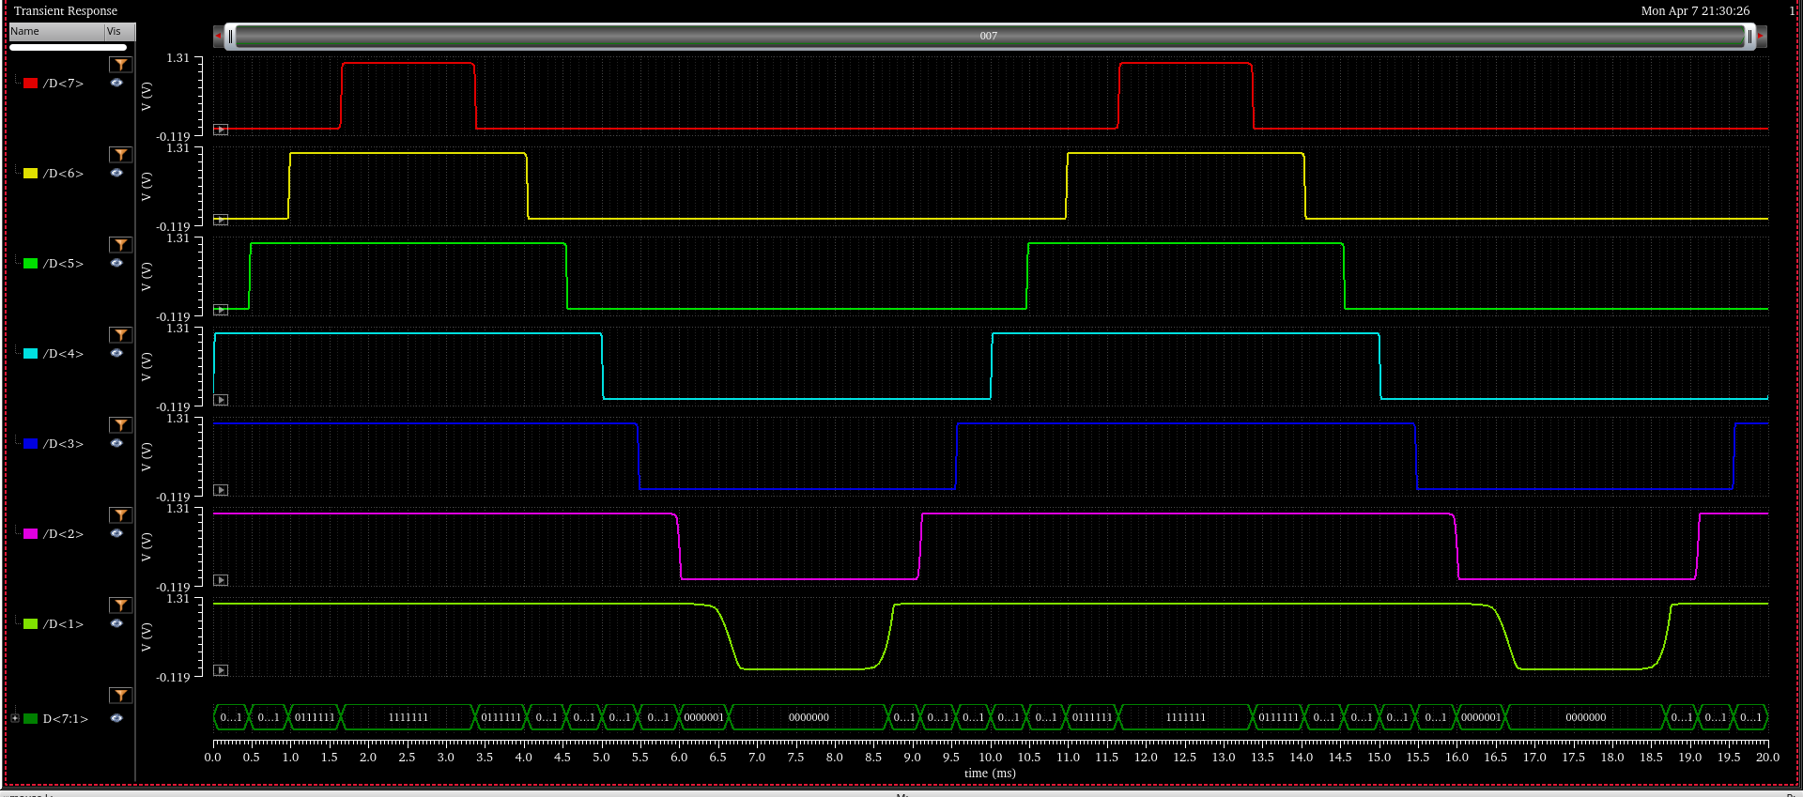
Voltage divider & Comparator Array
Vin (sine wave):
V_{dc} = 400mV
V_{amplitude} = 350mV
f = 100 Hz, 10k Hz, 1M Hz
Output of voltage divider:
100, 200, 300…700mV
Output of the Comparator Array
(Thermometer Code)

Slide 9
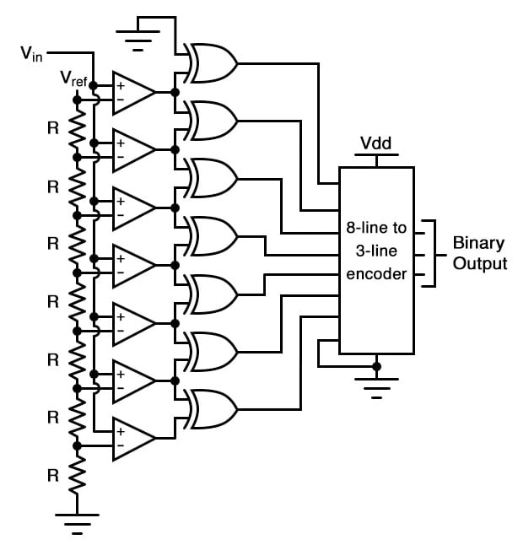
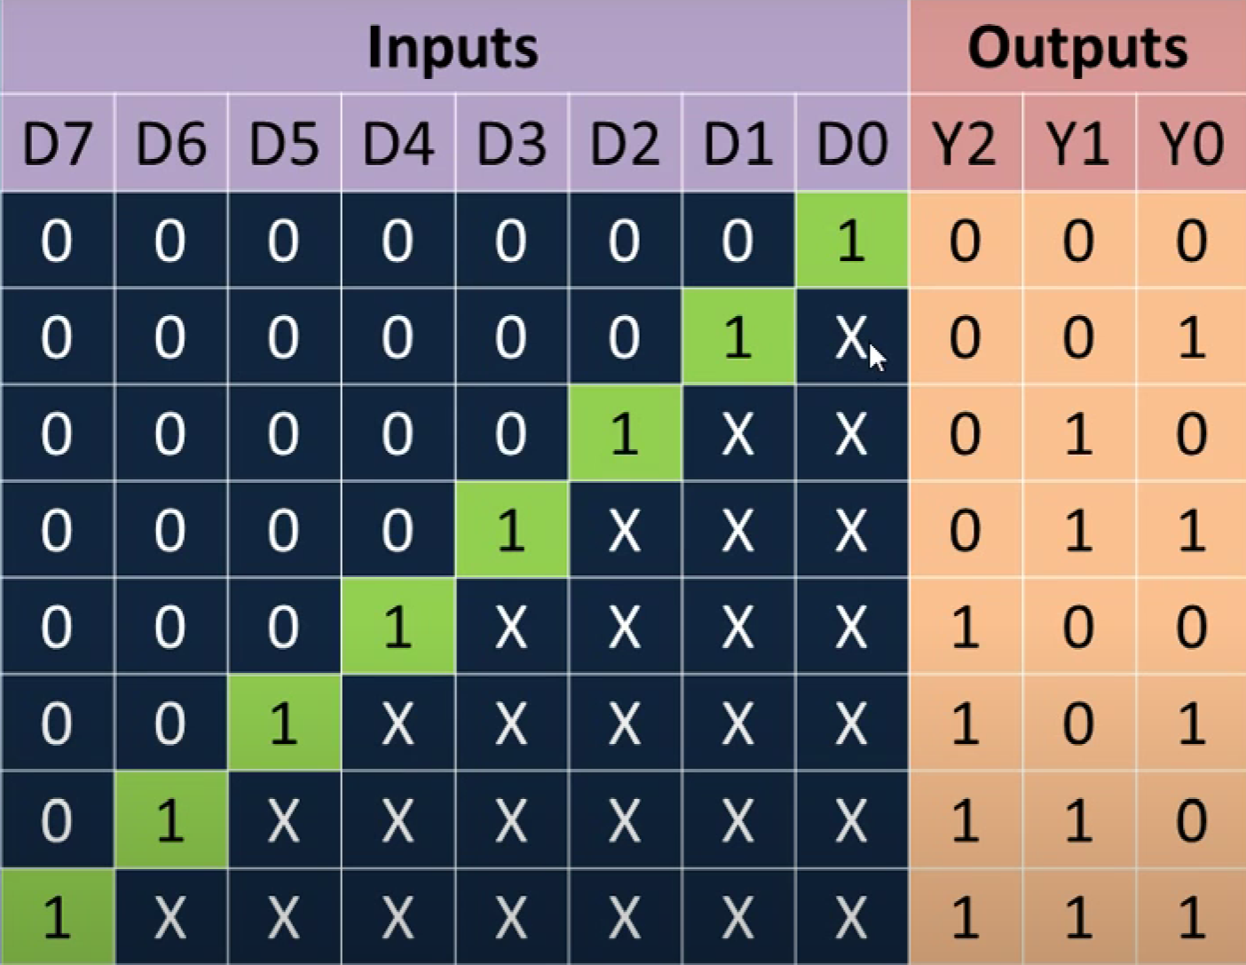
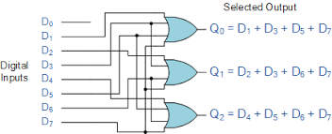
Priority Encoder
Schematic
Truth table
Notes:
Add an explanation for priority encoder function, and how to realize it XOR

Slide 10
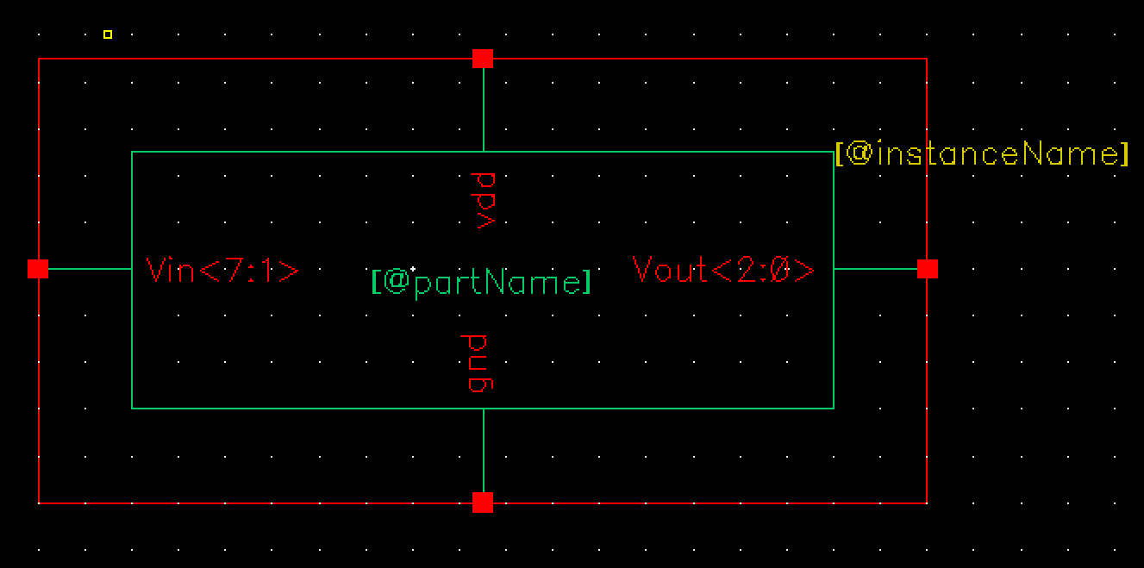
Priority Encoder
Symbol
Schematic

Slide 11
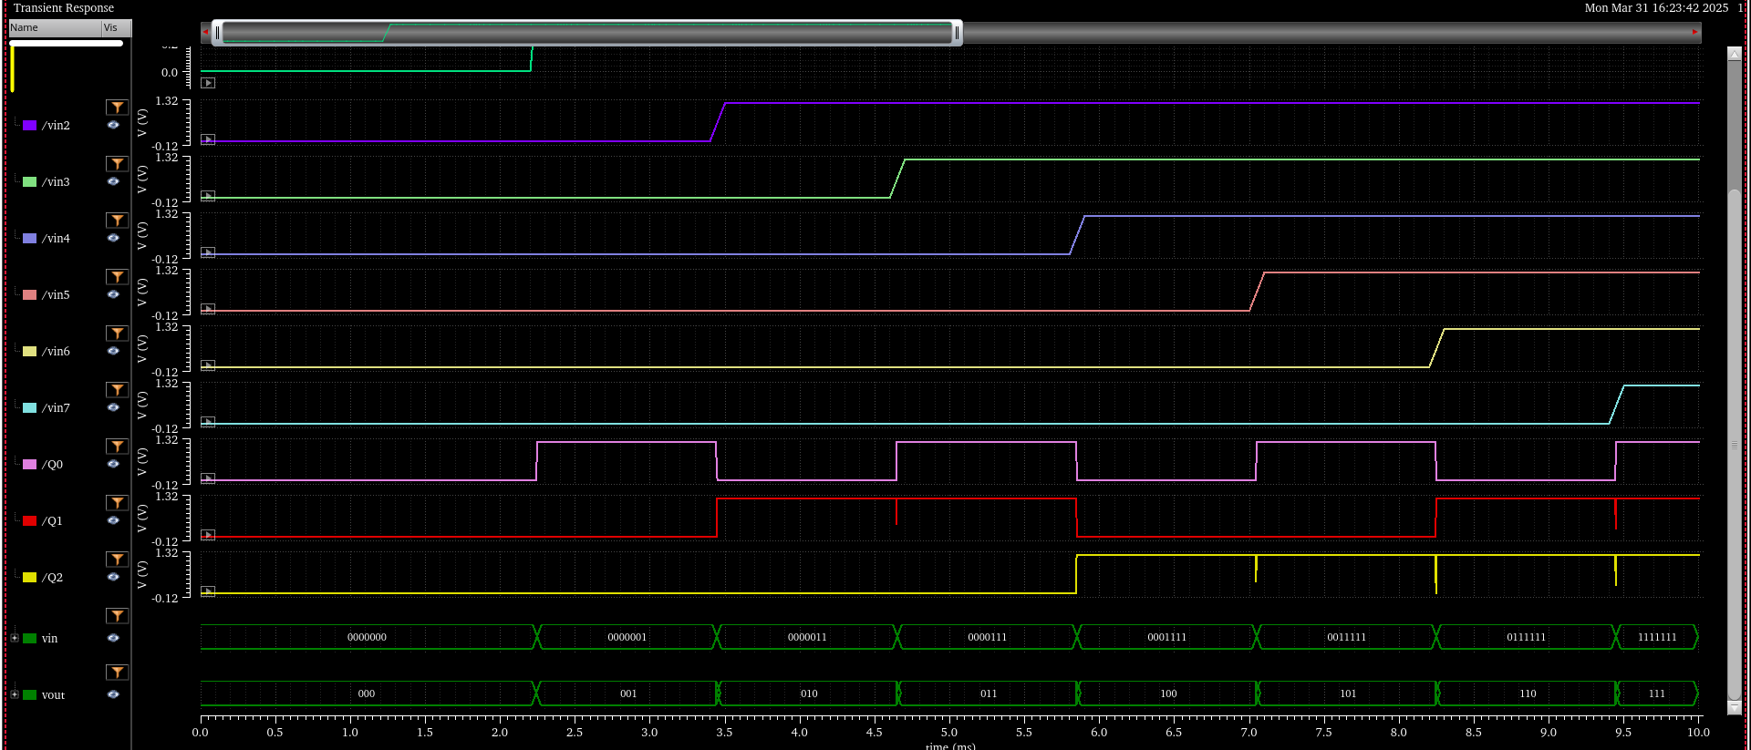
Priority Encoder
Waveform simulation: 7 bit in / 3 bit out

Slide 12
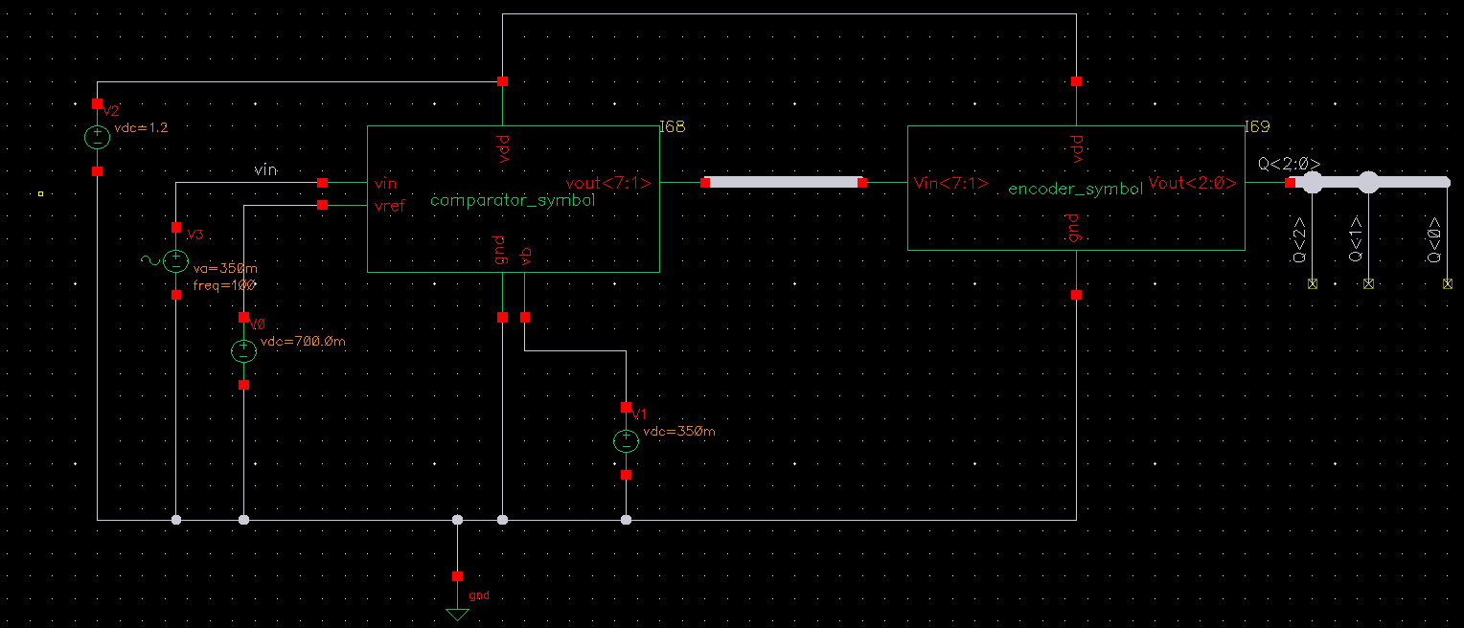
ADC Final Schematic
Schematic

Slide 13
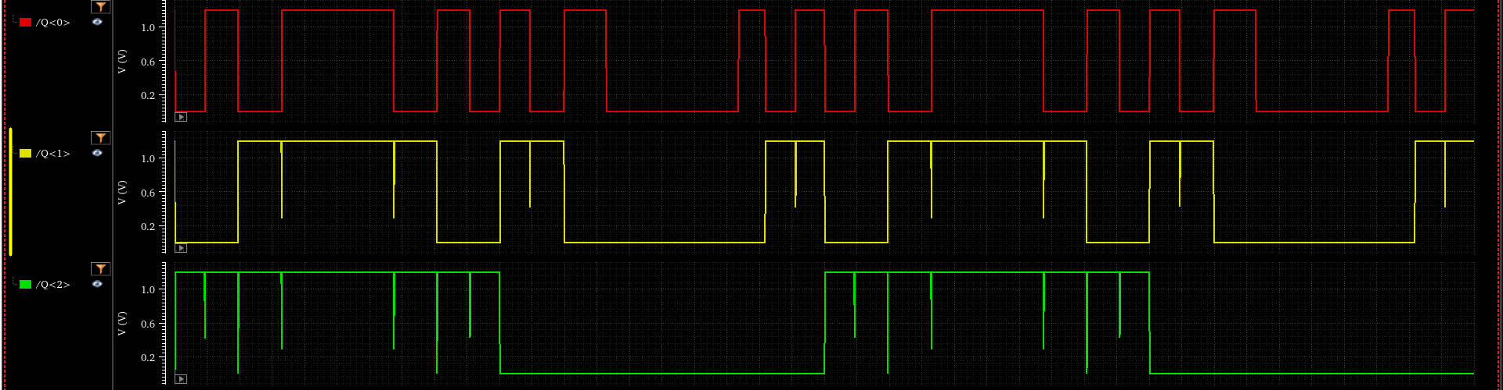
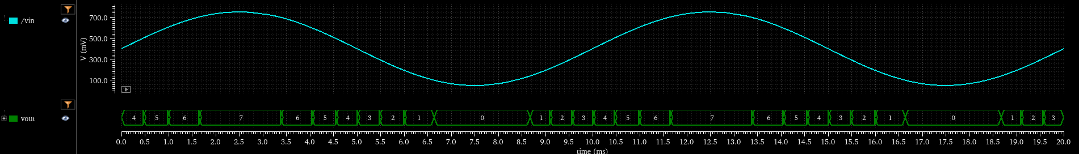
ADC Waveform Testing
3bit output
Sine wave input and digital output (oct)

Slide 14
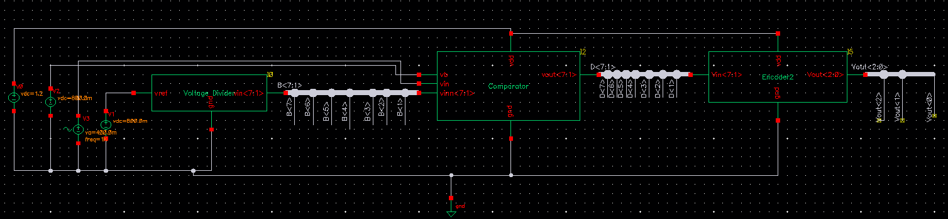
Flash ADC Update
Vbias of comparator: 800mV
Vin (sine wave): DC = 400mV; AC amplitude = 400mV

Slide 15
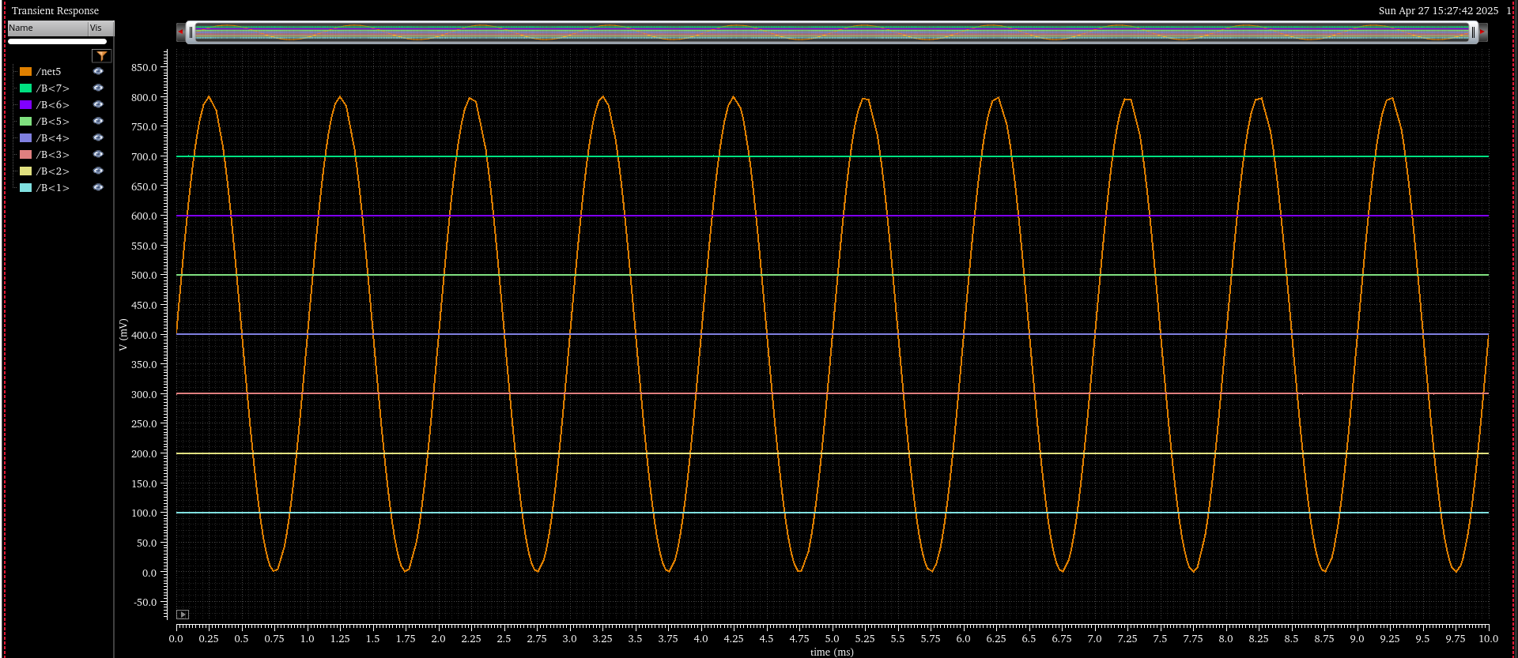
Flash ADC Update
Vbias of comparator: 800mV
Vin (sine wave): DC = 400mV; AC amplitude = 400mV

Slide 16
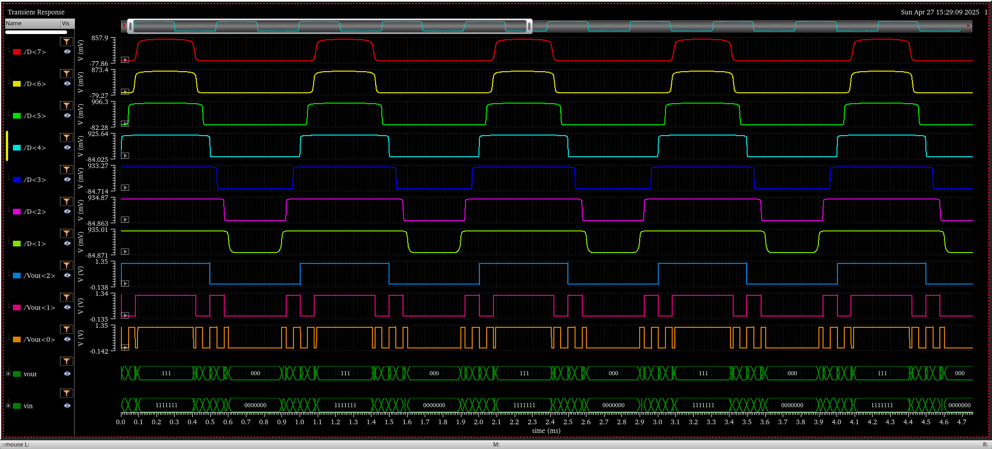
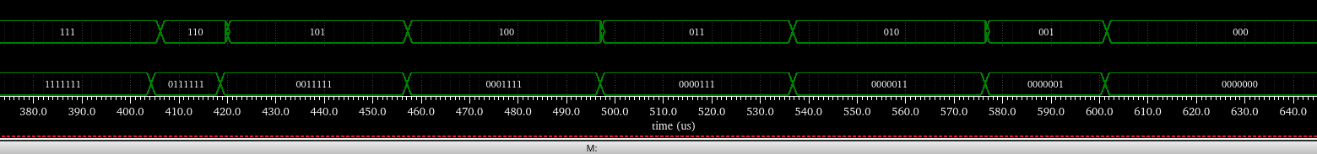
Flash ADC Update
Vin (sine wave): 1kHz

Slide 17
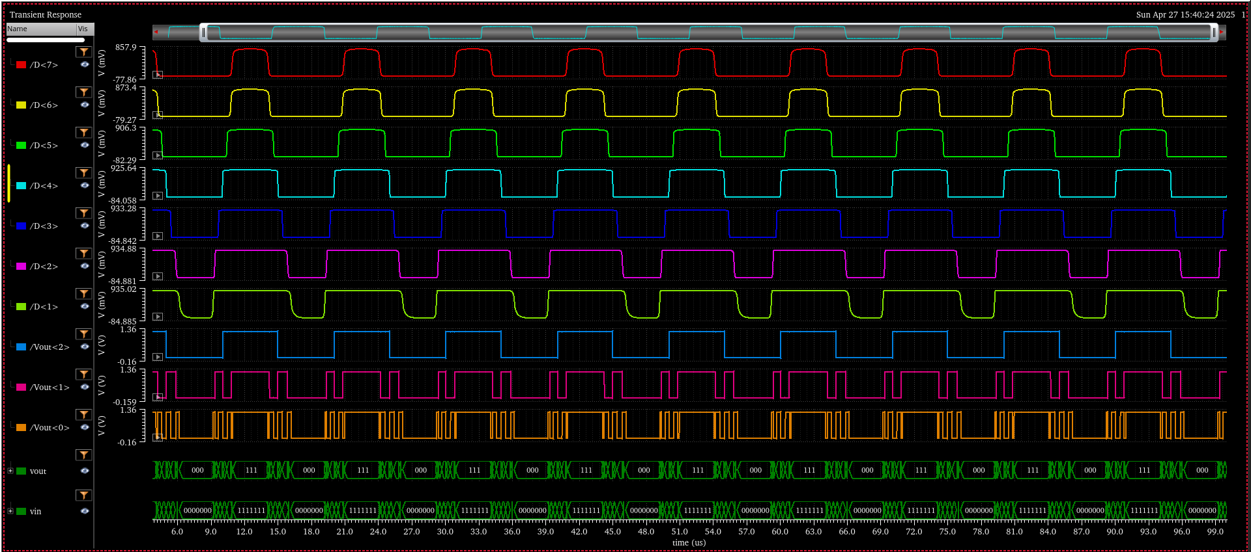
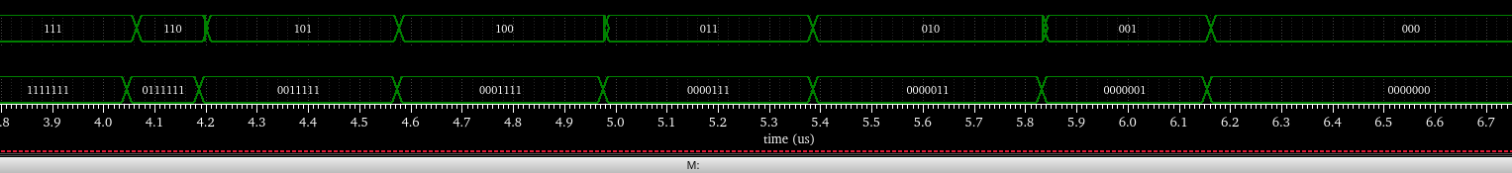
Flash ADC Update
Vin (sine wave): 100kHz

Slide 18
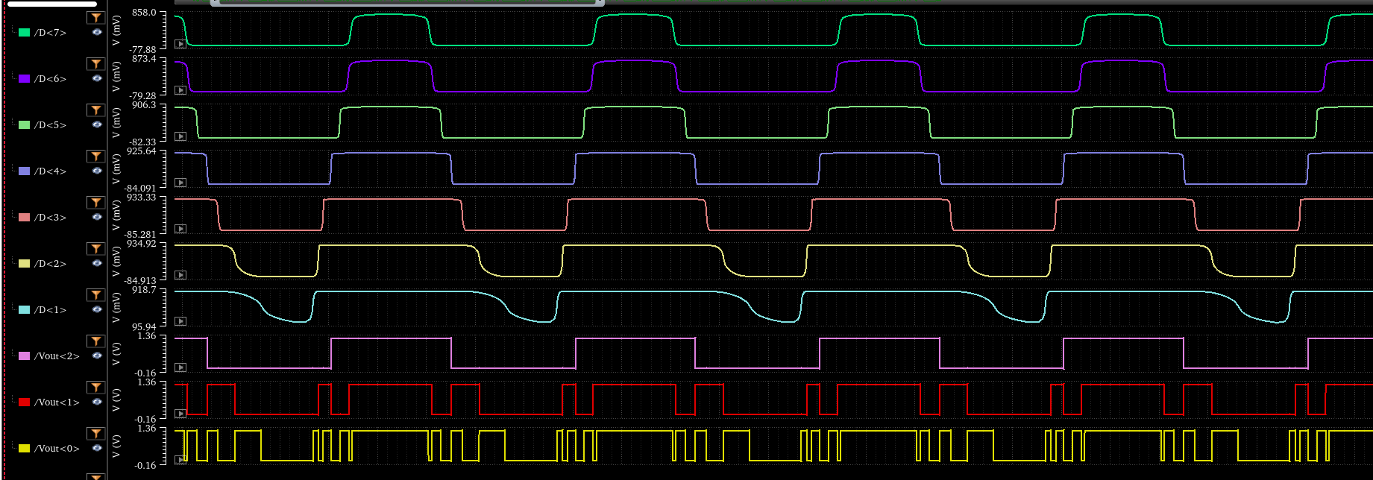
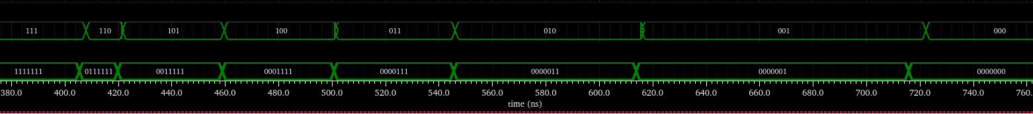
Flash ADC Update
Vin (sine wave): 1MHz

Slide 19
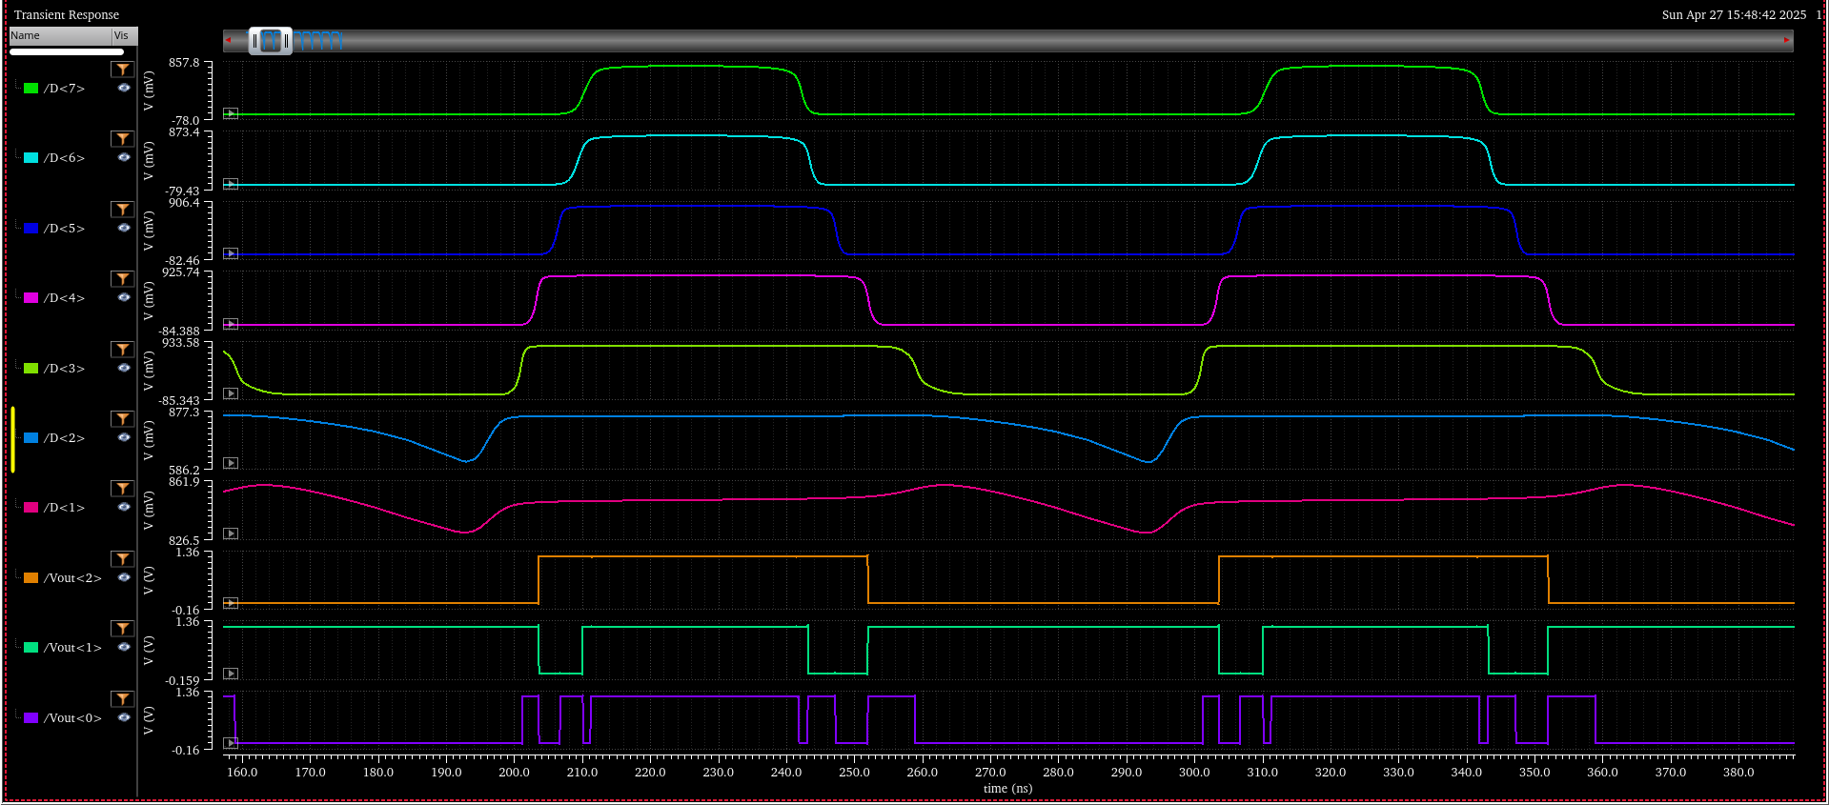
Flash ADC Update
Vin (sine wave): 10MHz
Error occurs

Slide 20
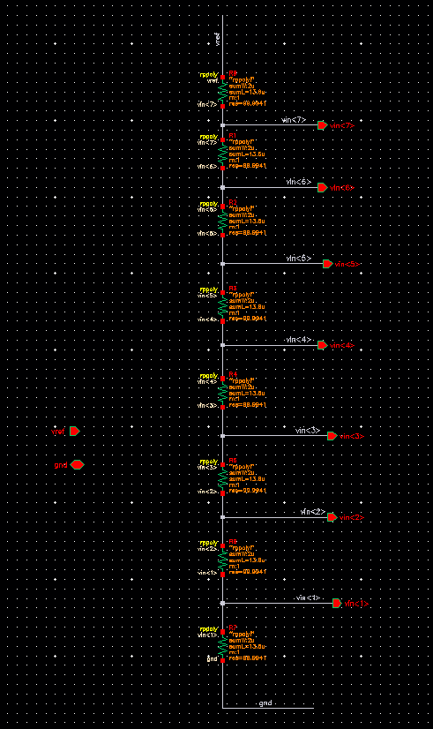
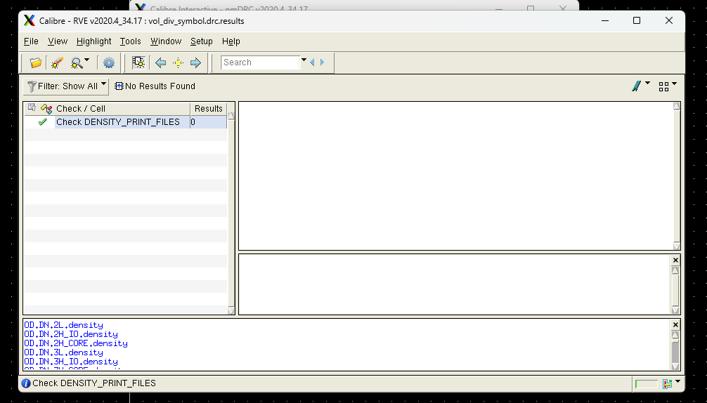
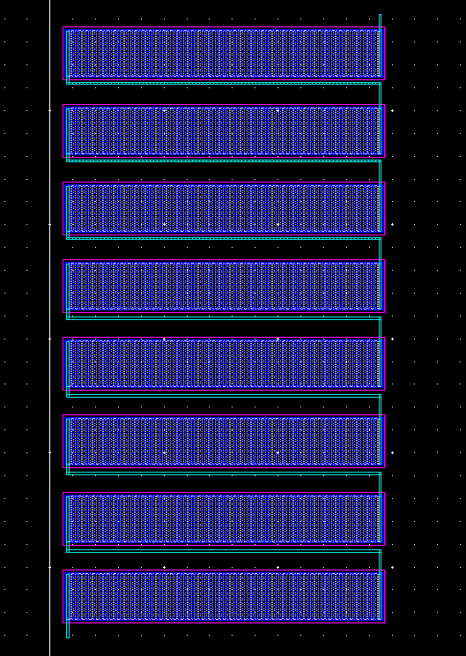
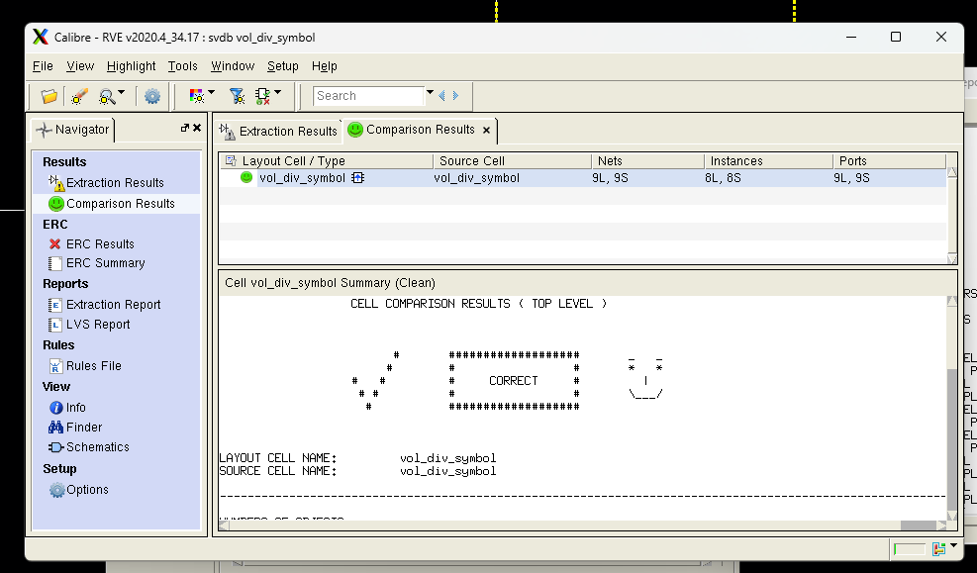
Resistor Ladder - vol_div_symbol

Slide 21
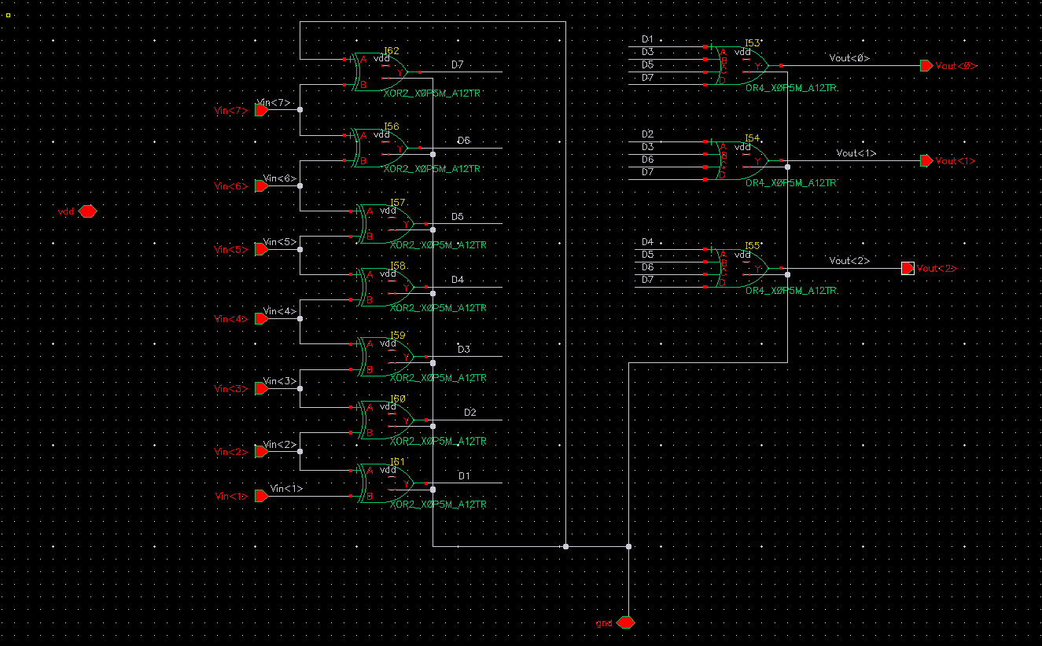
Priority Encoder – encoder_symbol

Slide 22
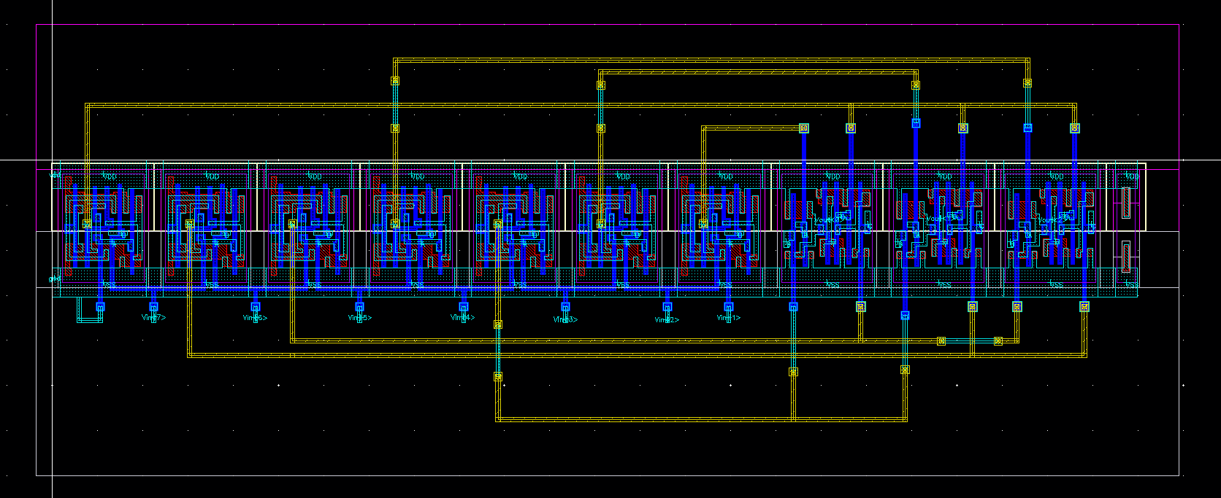
Priority Encoder - encoder_symbol

Slide 23
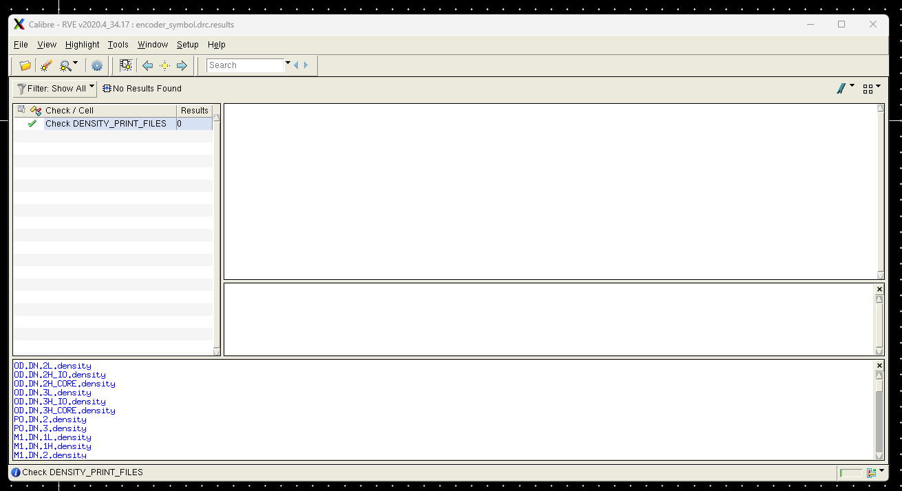
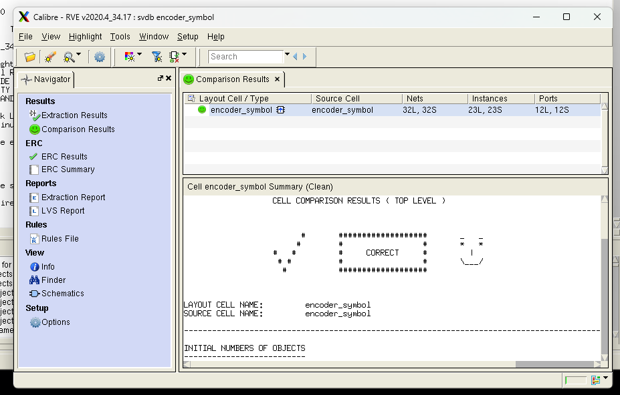
Priority Encoder - encoder_symbol

Slide 24
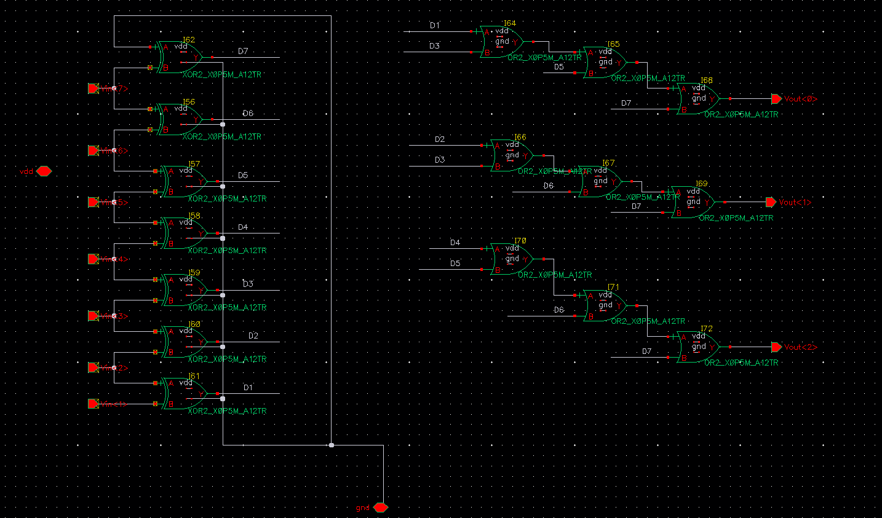
Priority Encoder

Slide 25
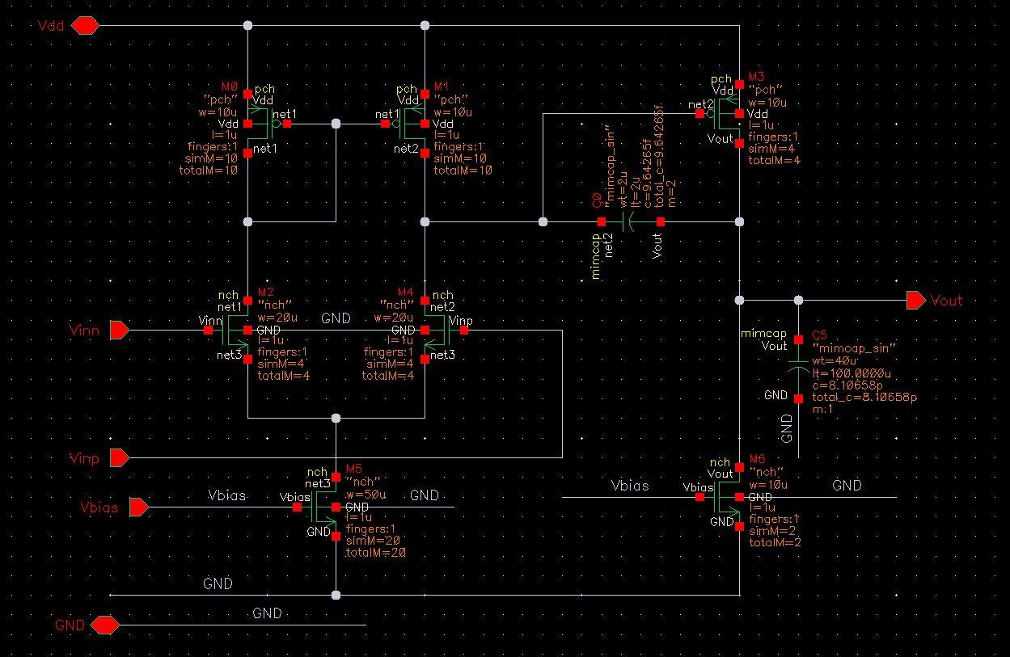
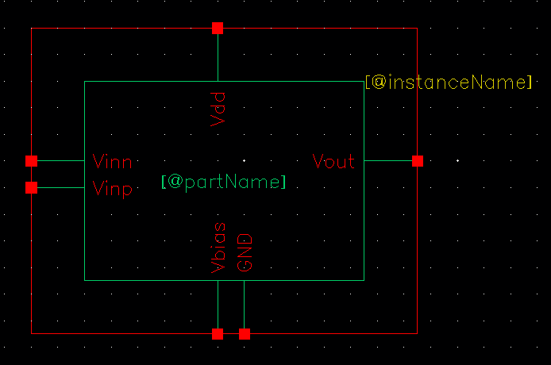
Differential Comparator - opamp

Slide 26
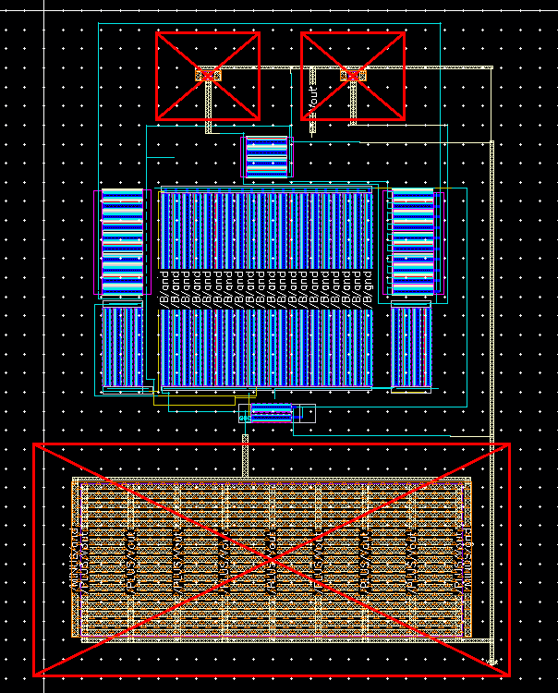
Differential Comparator - opamp

Slide 27
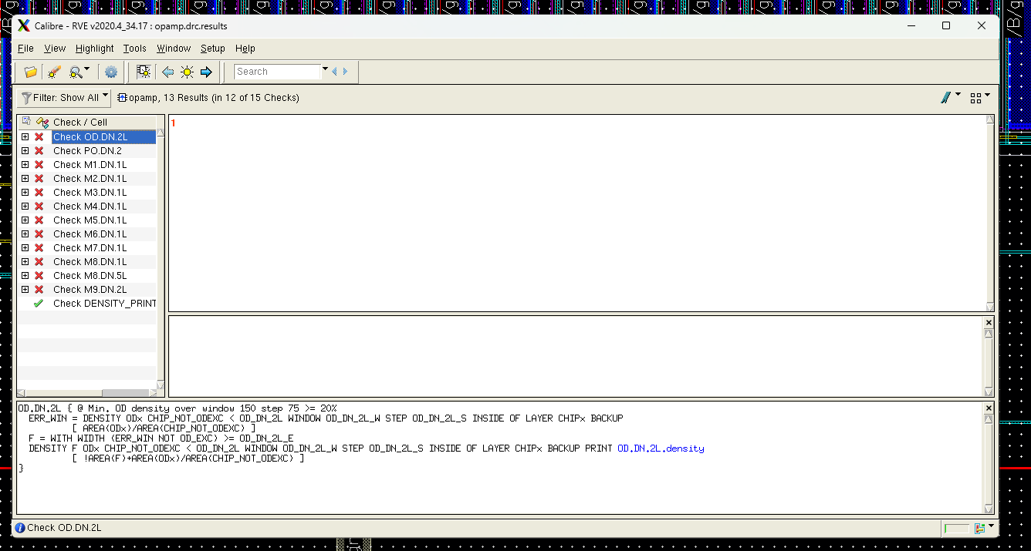
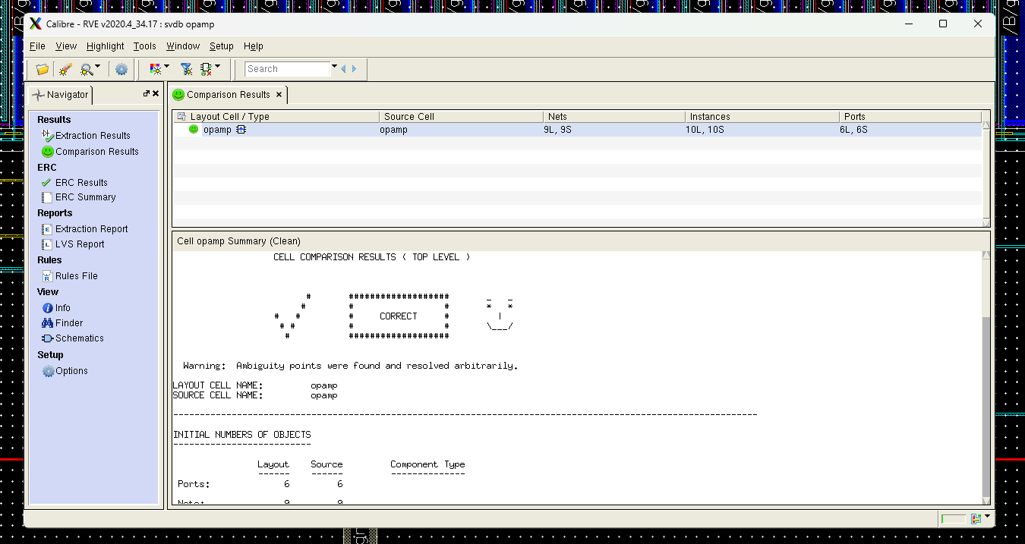
Differential Comparator - opamp

Slide 28
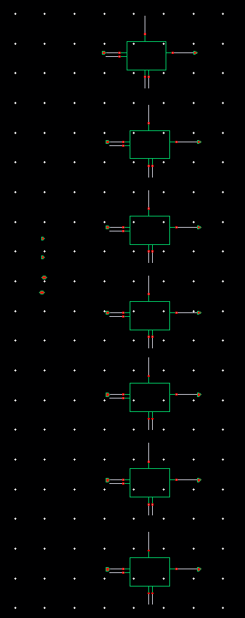
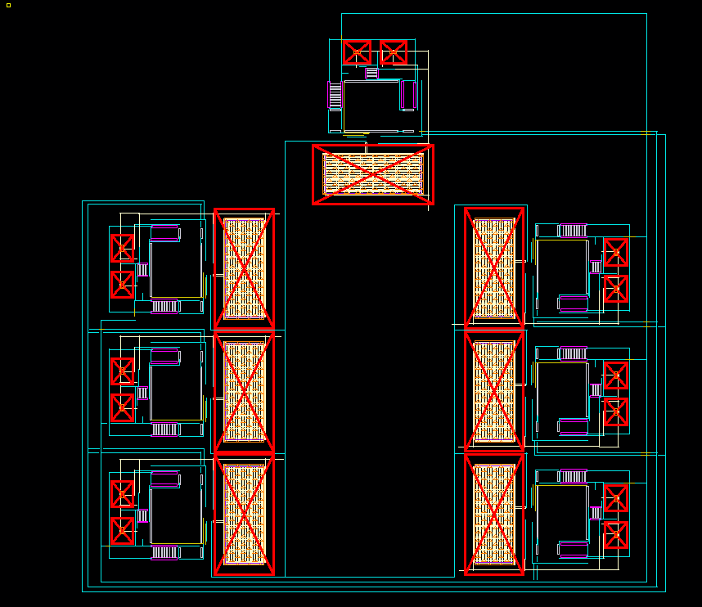
Differential Comparator - comparator_symbol

Slide 29
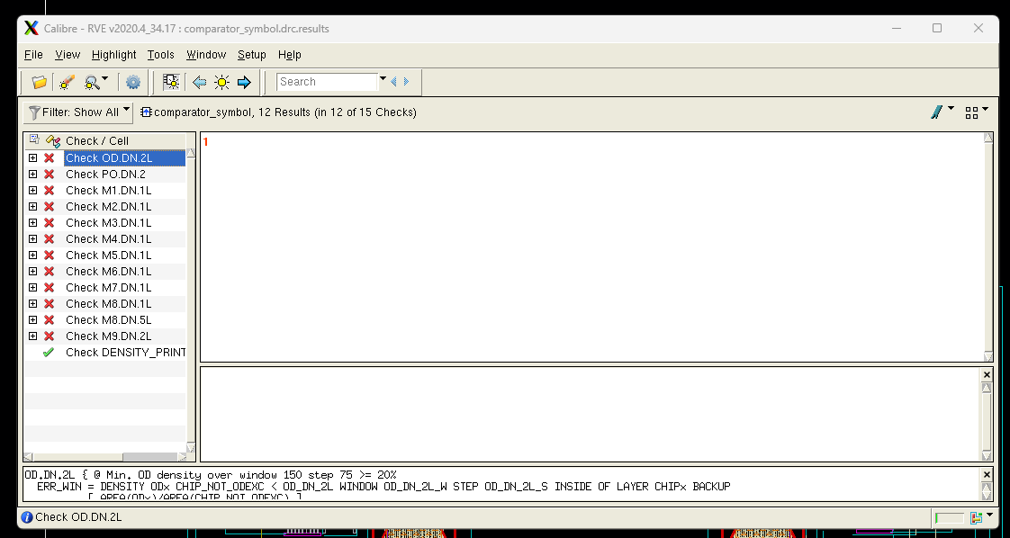
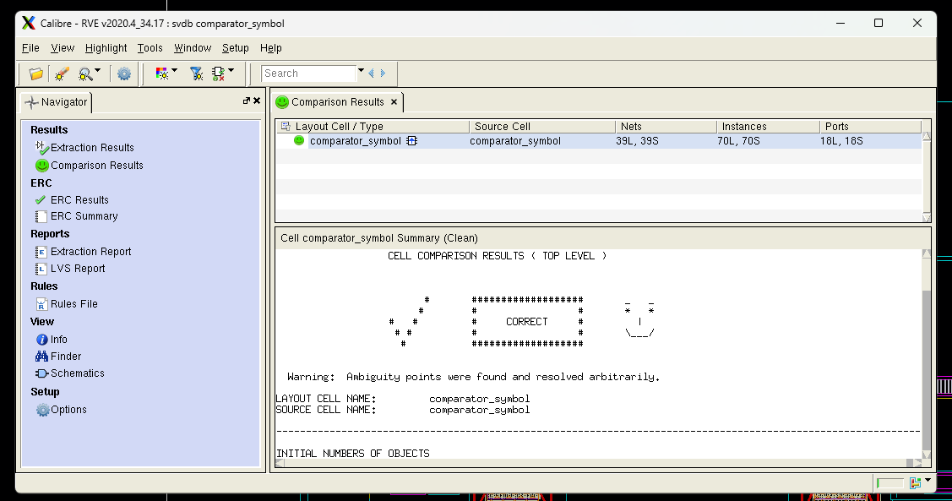
Differential Comparator - comparator_symbol

Slide 30
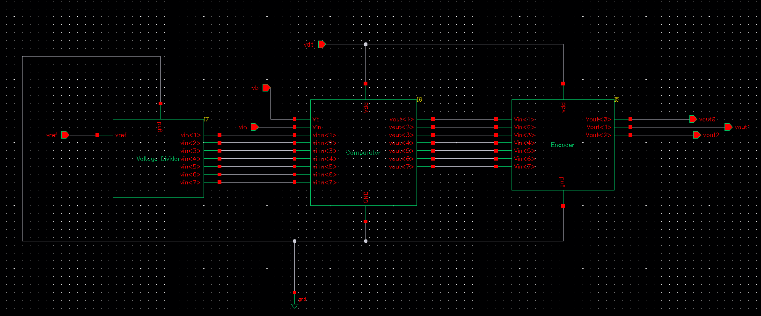
Flash ADC - ADC_final_test

Slide 31

Flash ADC - ADC_final_test

Slide 32


Flash ADC - ADC_final_test

Slide 33
What Else…
Schematic Design √
Resistor Ladder
Comparator
Encoder
Testing √
With DC inputs
With Sine wave input
Layout Design √
Resistor Ladder
Comparator
Encoder
Key Specs
Resolution | 3 bits
Supply Voltage | 1.2V
Area (Total) | 607um * 600um
Power
Sampling Rate | 1 MHz

Slide 34
Thanks

